Slide 1

SDET Course
Design Patterns - Decorator

Slide 2
3 Types of Design Patterns
Creational
Singleton
Builder
Prototype
Factory Method
Abstract Factory
Structural
Adapter
Composite
Proxy
Flyweight
Bridge
Facade
Decorator
Behavioral
Strategy
Observer
Command
Memento
State
Template Method
Mediator
Chain of Responsibility
Interpreter
Visitor
Iterator

Slide 3
Agenda
Description
Diagram
Code sample (Java)
Use cases

Slide 4

Description
Introduction - Decorator

Slide 5
Description
The Decorator design pattern is a structural pattern used to extend the functionality of objects in a flexible and dynamic manner without modifying their structure. It allows for the addition of responsibilities to objects on the fly, by wrapping them with new decorator classes that contain the additional functionality. This pattern is particularly useful for adhering to the Open/Closed Principle, one of the SOLID principles of object-oriented design, which states that software entities (classes, modules, functions, etc.) should be open for extension but closed for modification. Decorators provide a flexible alternative to subclassing for extending functionality, by composing objects with specific behaviors or functionalities at runtime, rather than inheriting them statically at compile time. This results in a more modular, scalable, and maintainable codebase, where changes can be made without affecting the existing code.

Slide 6
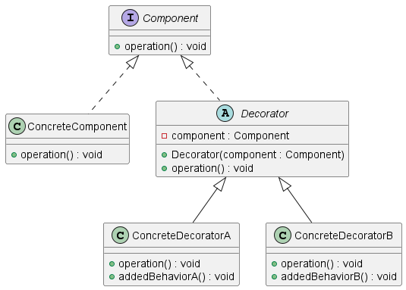
Class Diagram

Slide 7
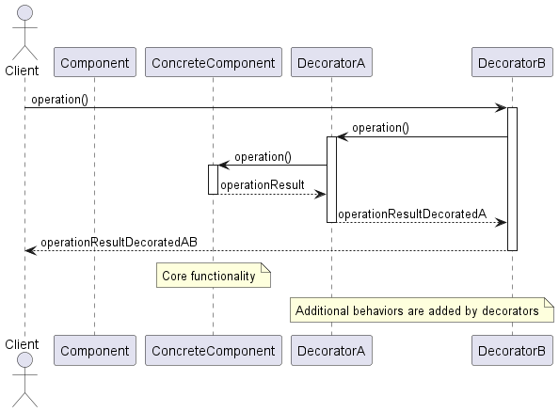
Sequence Diagram

Slide 8
Code Sample

Slide 9
Use cases
General
Permission and Role-based Access Control
Logging and Monitoring
Dynamic Feature Toggle
In Test Automation
Dynamic Test Configuration
Selective Test Retry Logic
Conditional Test Execution

Slide 10
Happy Coding

